Slide 1

Exploring health quality
Coung Huynh
Erica Rosa
Jensen Binoji
Ted Stagner

Slide 2

Background
From fee-for-service, towards value based care
Quality Incentive Programs
High performers → Positive reimbursement
Low performers → Negative reimbursement
Promotes QUALITY, OUTCOMES, and WELLNESS
For this project, we developed a platform the allows the user to explore data for the End-Stage Renal Disease Quality Incentive Program.

Slide 3
Data and methods
CSVs containing End-Stage Renal Disease QIP Reporting Results
Imported and transformed data in a Jupyter notebook (Pandas, SQL Alchemy)
Loaded dataframes into MySQL tables
Flask App to update visualizations through routes that query MySQL
D3 visualizations (js)
HTML Dashboard with CSS styling (WOW.js)

Slide 4
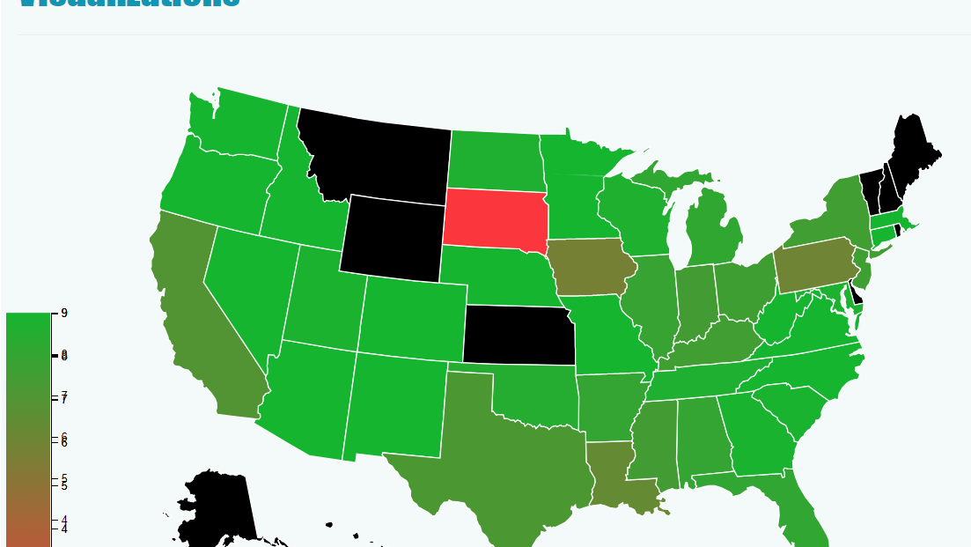
Chloropleth Map | State avgs

Slide 5
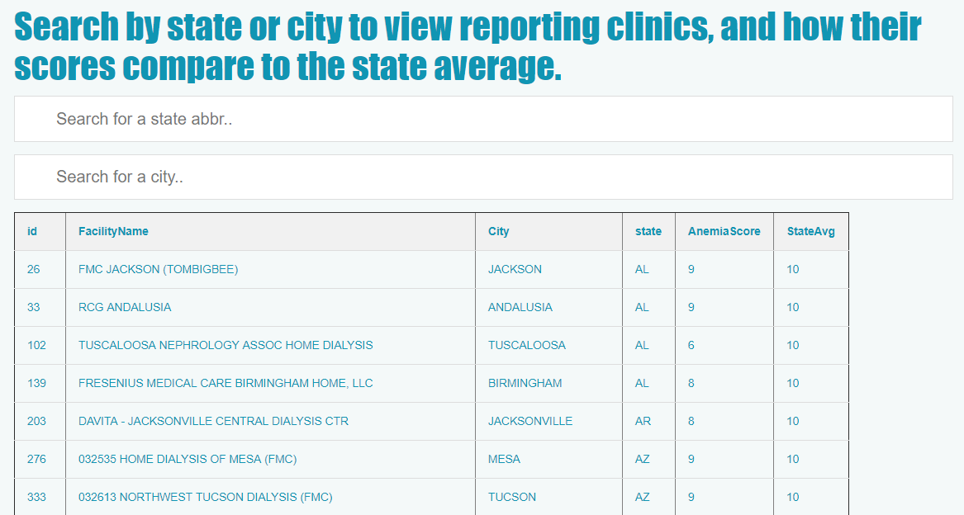
Filterable table| reporting clinics

Slide 6
Other Attempts| Angular.JS, D3 Bubble Plot

Slide 7
Demo
Local:5000

Slide 8
Thank you
Questions?

